Slide 1
Week-5
ARP, RARp, IPv4, IPv6

Slide 2
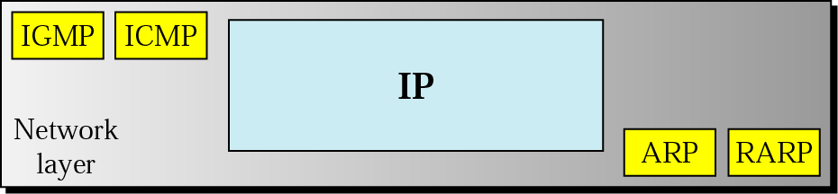
Protocols at network layer
Network layer Protocols
IGMP
IP (main protocol)
ARP
RARP
ICMPThe Internet Control Message Protocol .

Slide 3
IP criteria:
Responsible for host to host delivery of datagrams from a source to destination.
Needs a protocol called ARP to find the MAC(Physical) address of the next hop.
IP is designed for unicast delivery.
For multicasting, IP uses the services of IGMP.
During the datagram delivery, IP needs the services of ICMP to handle unusual situation (Error).
The current version is IPV6.

Slide 4
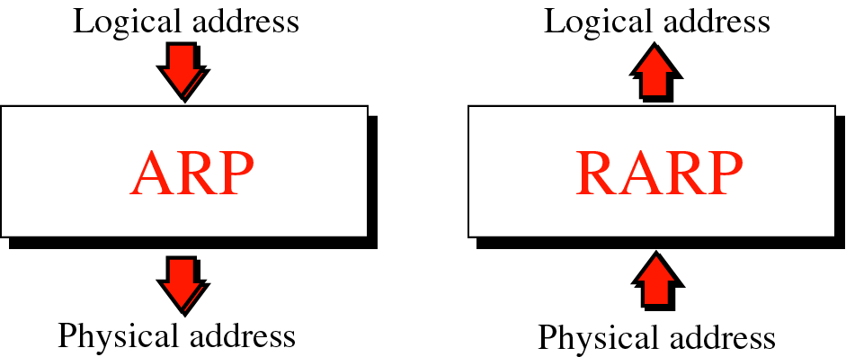

Slide 5
ARP
Mapping
Packet Format
Encapsulation
Operation

Slide 6
ARP (Address Resolution Protocol):
The hosts and routers are recognized at the network level by their IP addresses, which is universally unique.
The hosts and routers are recognized at the physical network by their MAC addresses, which is local and it should be unique locally but not necessarily universally unique.
The MAC address and IP address are two different identifiers, and both are equally necessary. Because a physical network (Ethernet) can have two different protocols (IP, IPX) at the network layer. In the same way a packet at network layer (IP) may pass through two different physical networks (Ethernet, Token Ring).
So delivery of a packet needs two levels of addressing (IP and MAC). It is necessary to map an IP address to its corresponding MAC address.

Slide 7
Mapping
Static mapping and Dynamic mapping
Static mapping:
Creates a table (in each machine of the network) that associates an IP address with a MAC address.
The machine that knows the IP address of other machine but not MAC address, can look through this table.
Static mapping table must be periodically updated.
Limitation:
A machine can change its network card, results in a new MAC address.
In some LANs (Local talk (Apple)), the MAC address changes every time the computer is turned on.
A mobile computer can move from one computer to another computer, results in a new MAC address.
Dynamic mapping (ARP, RARP)
Each time a machine knows one of the two addresses, it can use a protocol to find the other.
2 protocols (ARP and RARP) have been designed for dynamic mapping.
ARP maps an IP address to a MAC address.
RARP/DHCP maps a MAC address to an IP address.

Slide 8
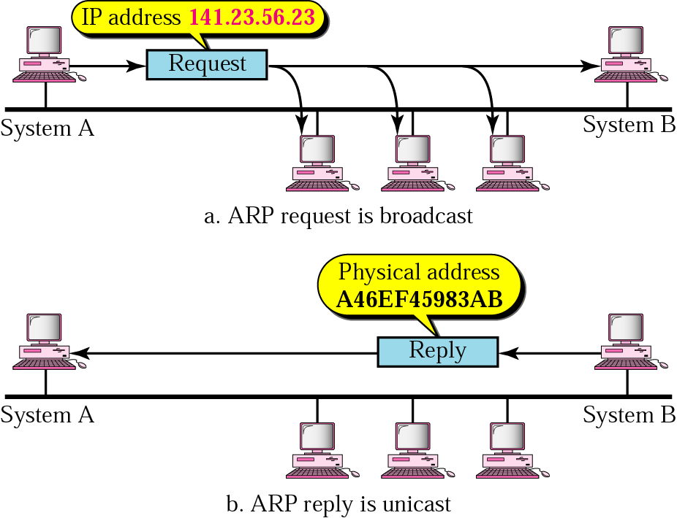
ARP operation

Slide 9
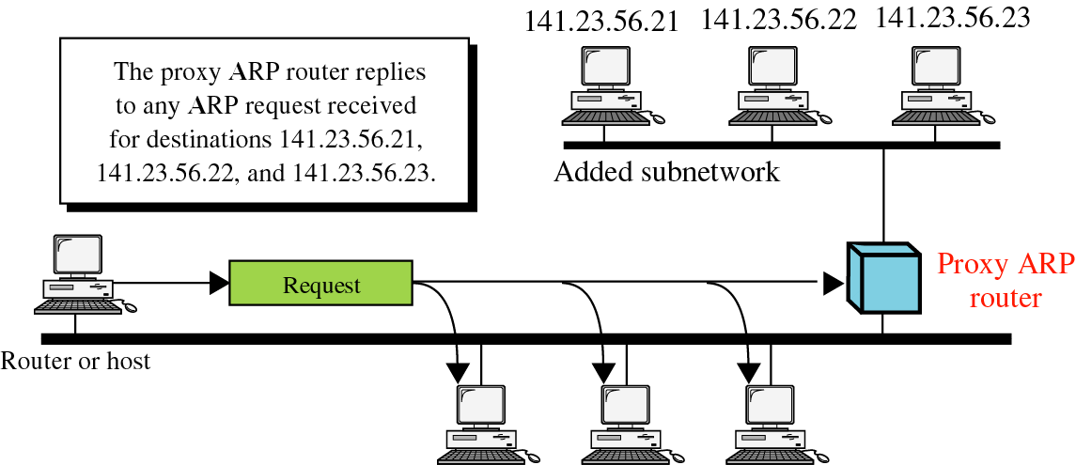

Slide 10
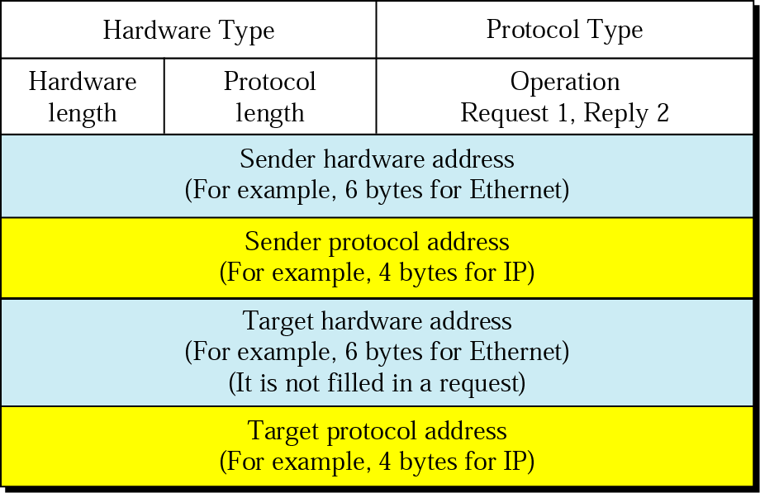
ARP packet

Slide 11
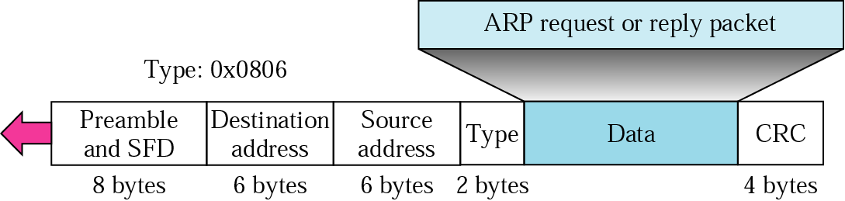
Encapsulation of ARP packet

Slide 12
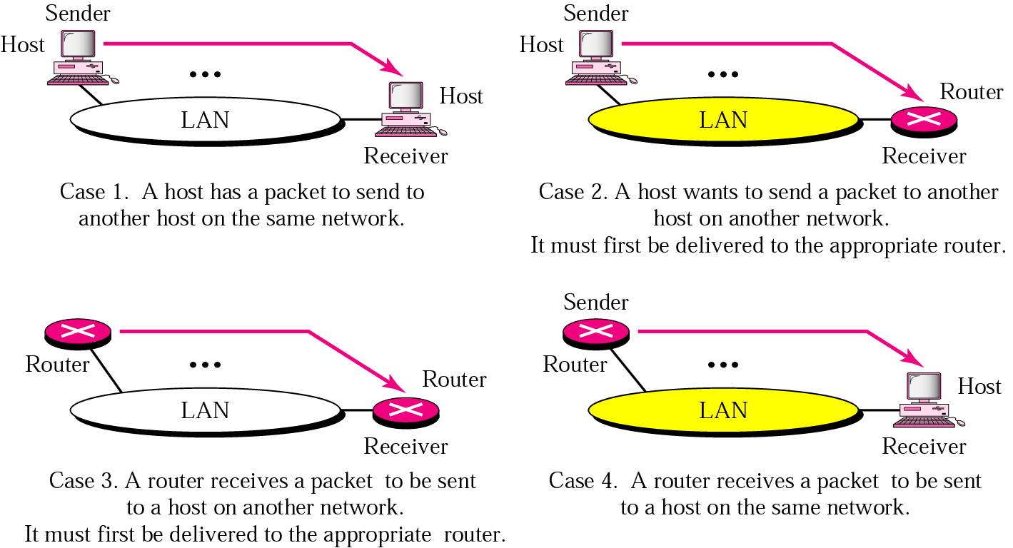
Four cases using ARP

Slide 13
Note:
An ARP request is broadcast; an ARP reply is unicast.

Slide 14
Example 1
A host with IP address 130.23.3.20 and physical address B23455102210 has a packet to send to another host with IP address 130.23.43.25 and physical address A46EF45983AB. The two hosts are on the same Ethernet network. Show the ARP request and reply packets encapsulated in Ethernet frames.
Solution
Figure shows the ARP request and reply packets. Note that the ARP data field in this case is 28 bytes, and that the individual addresses do not fit in the 4-byte boundary. That is why we do not show the regular 4-byte boundaries for these addresses. Note that we use hexadecimal for every field except the IP addresses.

Slide 15


Slide 16
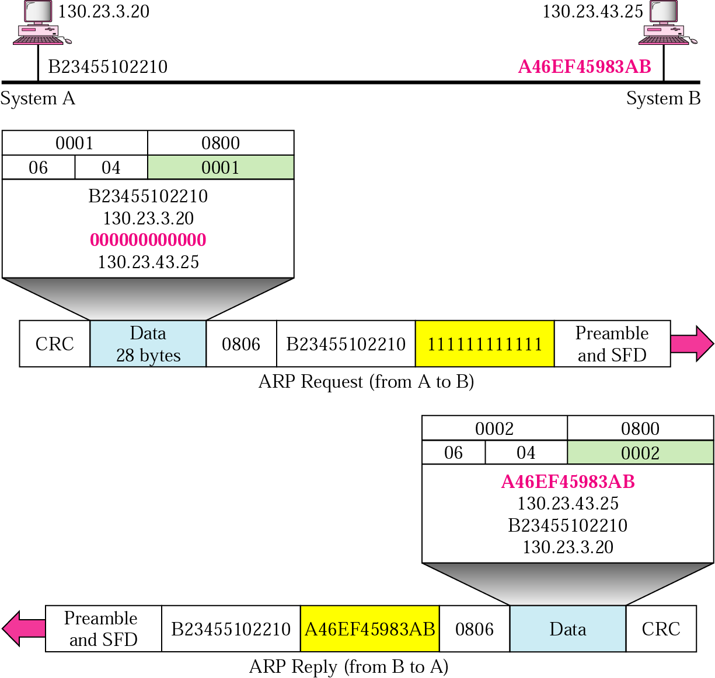
Example 1
cyclic redundancy check (CRC)
start frame delimiter (SFD)
An Ethernet frame

Slide 17
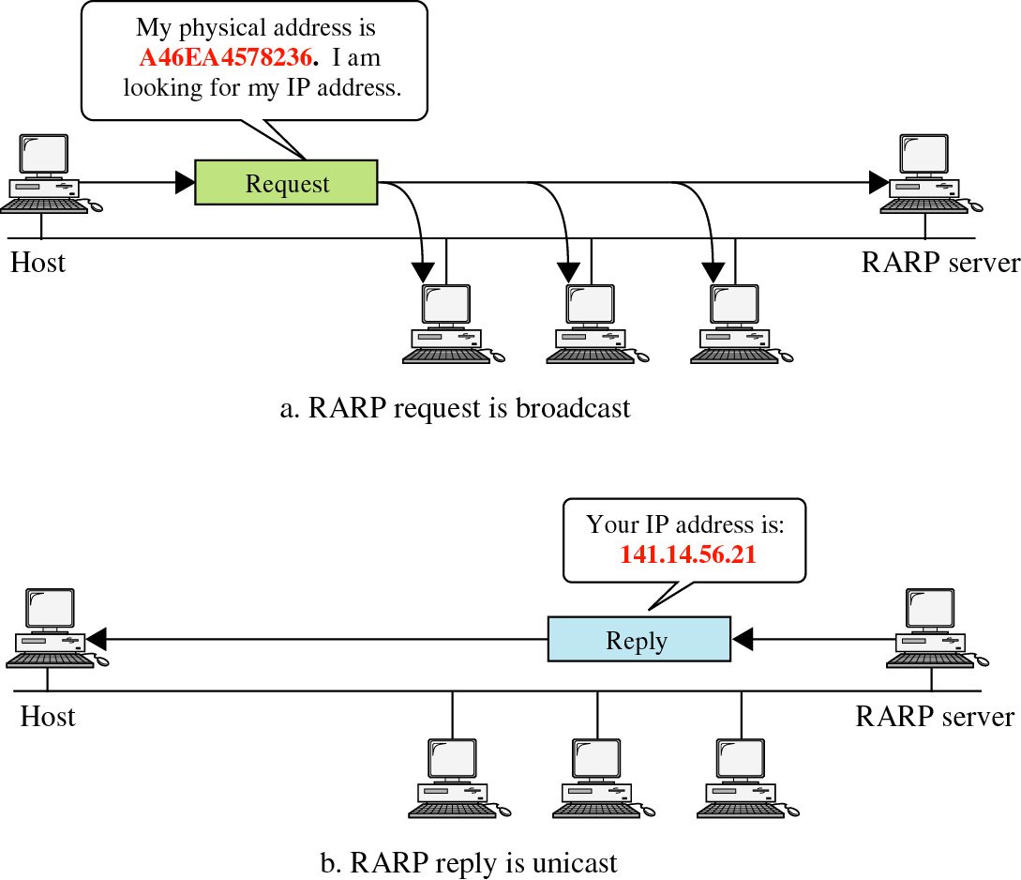
RARP

Slide 18
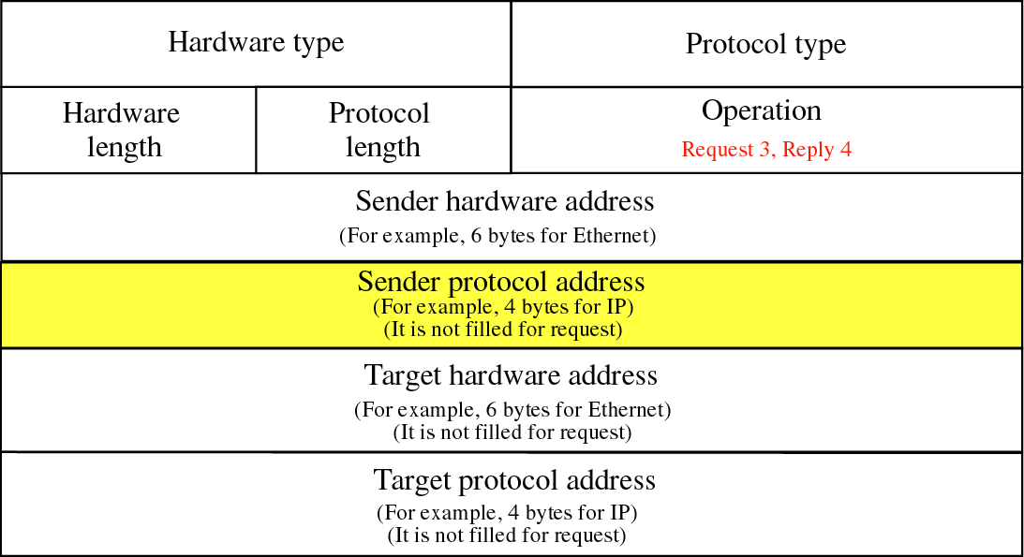

Slide 19
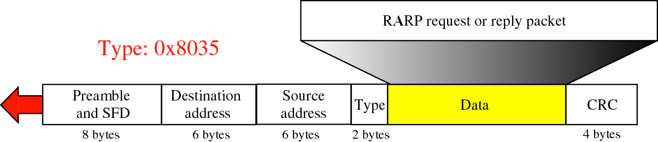

Slide 20
DHCP (Dynamic Host Configuration Protocol):
RARP (now obsolete) has been replaced by DHCP.
DHCP maps a MAC address to an IP address.
It provides the information dynamically based on demand.
It is used to assign addresses to a host dynamically.
Operation:
DHCP is a client server program.
DHCP server has two databases. The first database statically binds physical addresses to IP addresses. The second database makes DHCP dynamic.
When a DHCP client requests for a temporary, DHCP server goes to the pool of available IP addresses and assigns an IP address for a negotiable period of time.
When a DHCP client sends a request to a DHCP server, the server first checks its static database. If an entry with the requested physical address exists in the static database, the permanent IP address of the client is returned.
On the other hand, if the entry does not exist in the static database, the server selects an IP address from the available pool, assigns the address to the client, and adds the entry to the dynamic database.

Slide 21
DHCP Transition:

Slide 22
DHCP Transition states:
(1) Initialization state:
The DHCP client broadcasts a DHCP DISCOVER message.
(2) Selecting state:
The servers that provide this type of service respond with a DHCP OFFER message.
DHCP OFFER message includes IP address and lease duration.
The server that sends DHCP OFFER message, locks the IP address, so other clients cannot use it.
If the clients receive no DHCP OFFER message, it tries 4 times, after every 2 seconds. Finally if fails the clients
sleeps for 5 minutes, before trying again.
On the other hand, if the client receives the DHCP OFFER message, it sends a DHCP REQUEST message to the
selected server.
(3) Requesting state:
Here client waits until it receives DHCP ACK message from the server, which binds the client’s physical address
and its IP address.
(4) Bound state:
In this state client can use the IP address until the lease expires. If the lease expires it goes to the initial state.
If 50% of the lease period expires, the client sends DHCP REQUEST for renewal. If the server agrees, it sends
DHCP ACK message to the client
(5) Renewing state:
If client receives DHCP ACK message from the server, it renews the lease agreement.
If the lease time 87.5% expires and the DHCP client does not receive the DHCP ACK message, it sends the
DHCP REQUEST to the server and goes to the Rebinding state.
(6) Rebinding state:
If client receives DHCP ACK message from the server, it renews the lease agreement.
If the lease time expires or the client receives a DHCP N ACK message from the server, it goes to the
initialization state.

Slide 23
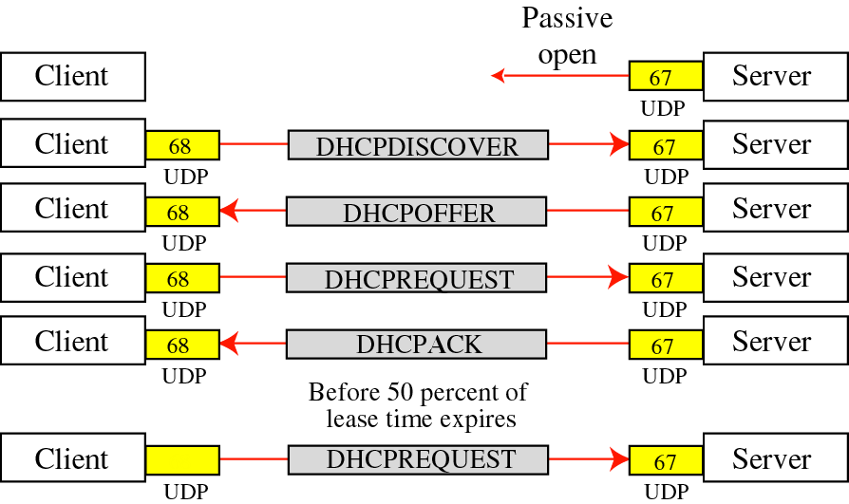
(Exchanging messages)

Slide 24
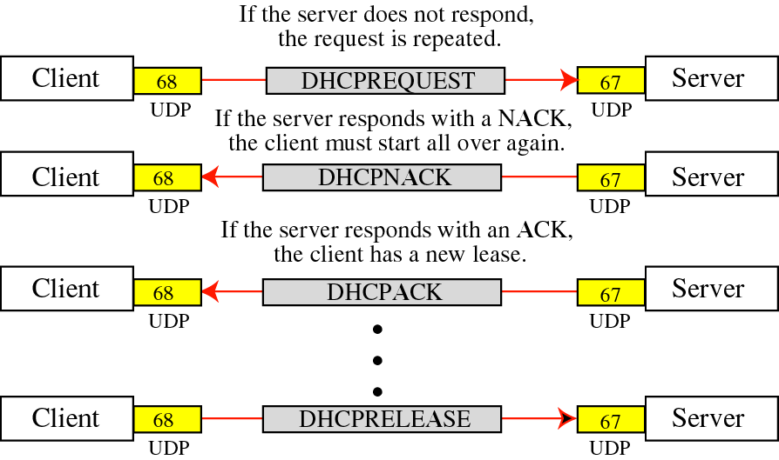

Slide 25
20.2 IP
Datagram
Fragmentation

Slide 26
Characteristics:
Host to host delivery protocol for the internet.
Unreliable and connectionless datagram protocol (best effort delivery service) and also applicable for packet switching network.
IP provides no error and flow control mechanism.
IP provides only error detection mechanism and discards the packet if it is corrupted.
For reliability, IP is paired with TCP.

Slide 27
Continue……
Datagram:
A datagram variable length packet has two parts. Header and Data.
Header 20 -60 bytes | Data (65536-20)→ ((65536-60) bytes

Slide 28
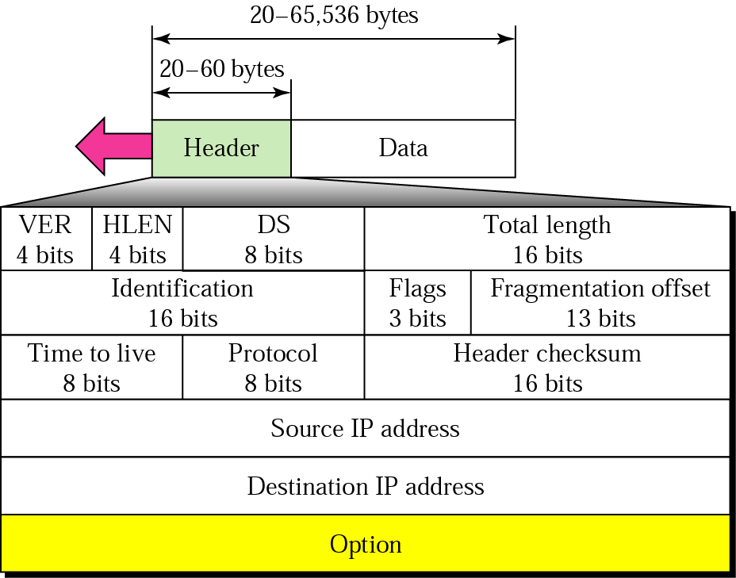
IP datagram

Slide 29
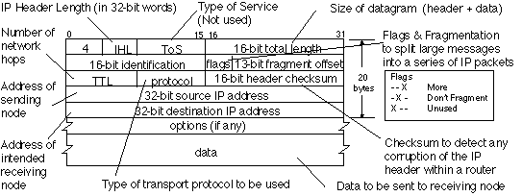

Slide 30
Note:
The total length field defines the total length of the datagram including the header.

Slide 31
Version: IPV4
Header length:
Length of the header is variable.
Length of the datagram is 4 byte words.
Differentiated services:
This is necessary for quality of service purposes.
Total length:
Length of data = total length-header length
Total length of the IP datagram = (2₁₆-1) bytes = 65535 bytes. [16 bits]
Time to live:
Controls the maximum number of hops (routers) visited by the datagram.
When a source node sends a datagram, stores a number approximately 2 times the maximum number of routes between any two hosts. Each router that process the datagram decrements this number by 1. If the value is 0, the router decrements the datagram.
Protocol:
An IP datagram encapsulates data from several higher-level protocols, such as TCP, UDP, ICMP and IGMP.
This field specifies the final destination protocol, to which the IP datagram should be delivered.
DHL to DHL

Slide 32
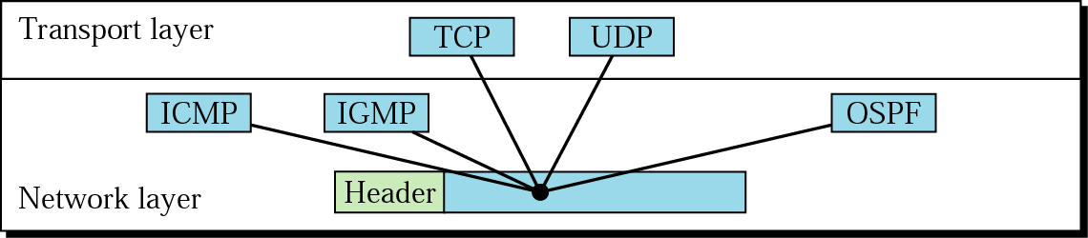
Multiplexing
Demultiplexing

Slide 33
Protocols
Checksum:
The checksum in the IP packet covers only the header, but not the data. The reasons are:
The checksum for the IP datagram doesn’t have to check the encapsulated data.
The header of the IP packet changes with each visited router, but the data do not.

Slide 34
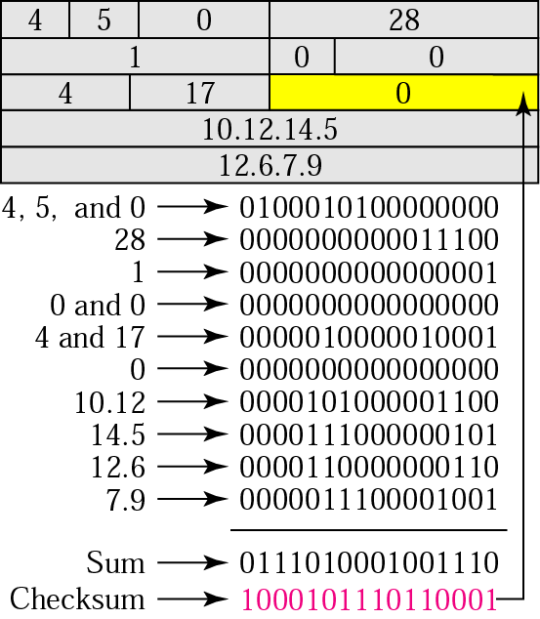
Example of checksum calculation

Slide 35
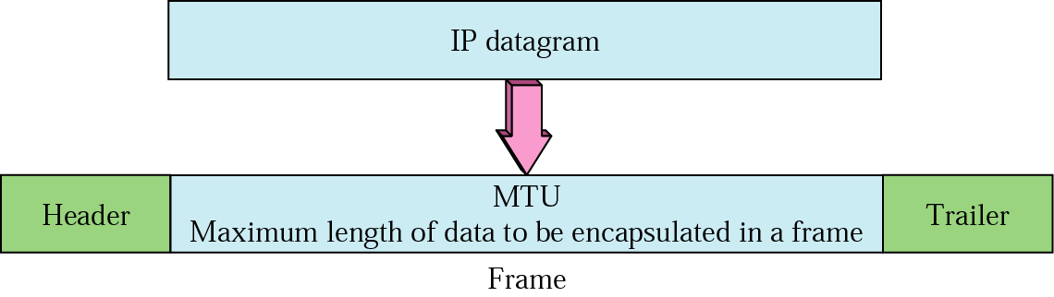
MTU
Maximum transfer unit: (MTU)
When a datagram is encapsulated in a frame, the total size of the
datagram <= maximum size (depends on hardware and software of the network).
The maximum length of the IP datagram = the largest maximum transfer
unit (MTU) = 65535 bytes.
For other physical networks, we must divide the datagram to make it possible
to pass through these networks.
A datagram can be fragmented by the source host or any router in the path.
Reassembly will be done at the destination.

Slide 36
Fields related to fragmentation:
Flags:
This is a 3-bit field.
The first bit is reserved.
The second bit is “Do not fragment bit”. If its value is 0, the datagram can be fragmented. If the value is 1, the machine must not fragment the datagram.
The third bit is called “The more fragment bit”. If the value is 1, it means the more datagram exit after the current fragment. If the value is 0, it means this is the last or only fragment.

Slide 37
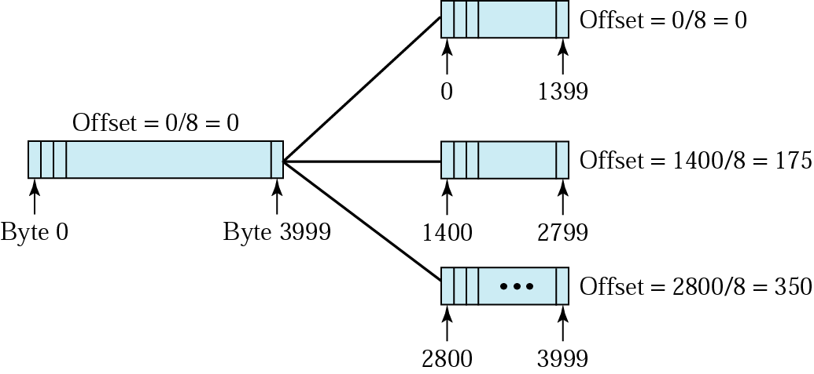
Fragmentation example
Fragmentation offset:
This 13 bit field shows the relative position of this fragment with respect to the whole datagram.

Slide 38
IPv6
IPv6 Addresses
Categories of Addresses
IPv6 Packet Format
Fragmentation
ICMPv6
Transition

Slide 39
Demerit of IPV4:
IPV4 has a two-level address structure (net ID and host ID) categorized into five classes. The address space is insufficient.
Internet must accommodate encryption and authentication of data for some applications. Originally no security mechanism was provided in IPV4.
Internet must accommodate real time audio and video transmission. This requires minimum delay strategies and reservation of resources. This is not provided in IPV4.

Slide 40
Merit of IPV6 over IPV4:
Larger address space: An IPV6 address is 128 bits long, while IPV4 has 32 bits.
Better header format: Here options are separated from the base header and the upper layer data.
New options: Allow options for additional functionalities.
Allowance for extension: Allow the extension of the protocol, if required by new technologies or applications.
Support for resource allocation: Flow level has been added to enable the source to request special handling of the packet and to support traffic (real time audio and video).
Support for more security: The encryption and authentication options in IPV6 provide confidentiality and integrity of the packet.

Slide 41
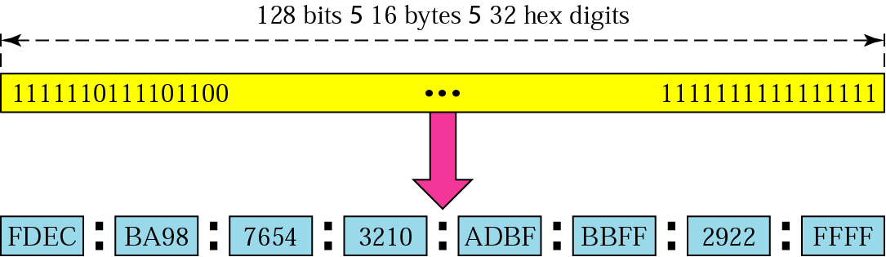
IPv6 address

Slide 42
IPv6 Categories of addresses:
IPV6 defines three types of addresses:
Unicast address
Anycast address
Multicast address
Unicast address
Defines a single computer
Anycast address
Anycast address is a new type of address incorporated in IPv6.
It defines a group of computers with addresses that have the same prefix.
In contrast to conducting transmission to all nodes in a group as in multicast, anycast sends the packet only to the nearest node in the group.
Multicast address:
A packet sent to a multicast address must be delivered to each member of the set.

Slide 43
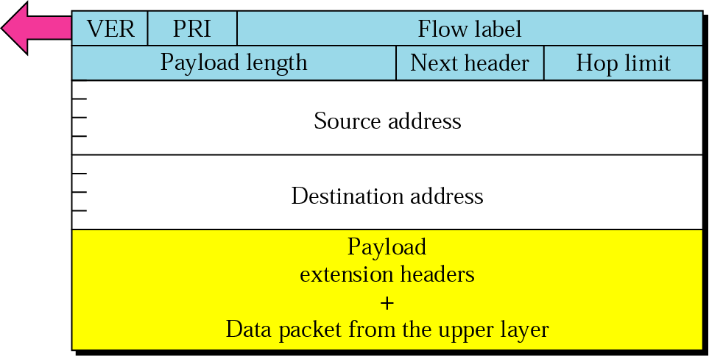
Format of an IPv6 datagram
Traffic Class

Slide 44
Fragmentation in IPv6:
The policy is same as that of IPV4.
In IPV4, a source or router is responsible to fragment the datagram if necessary.
In IPV6, only the source is responsible to fragment the datagram.
A source uses a path MTU discovery technique to find the smallest MTU supported by any network on the path.
If path MTU discovery technique is not used, the source must fragment the datagram to a size of 576 bytes or smaller.

Slide 45
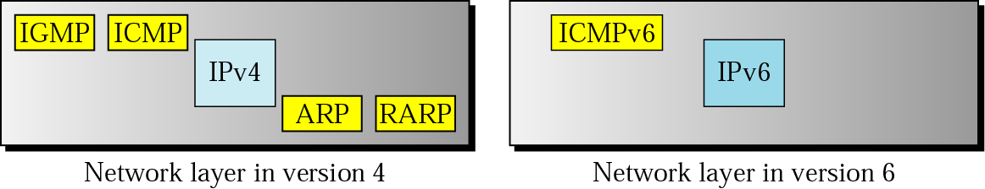
Comparison of network layers in version 4 and version 6

Slide 46
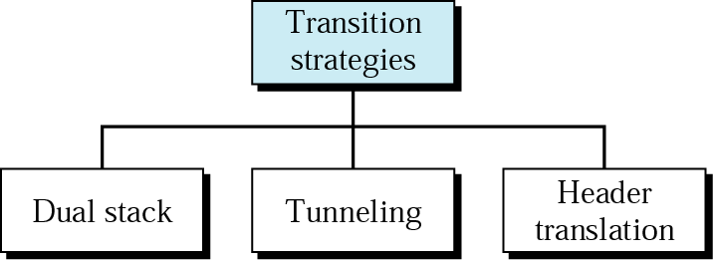
Three transition strategies from IPv4 to IPv6

Slide 47
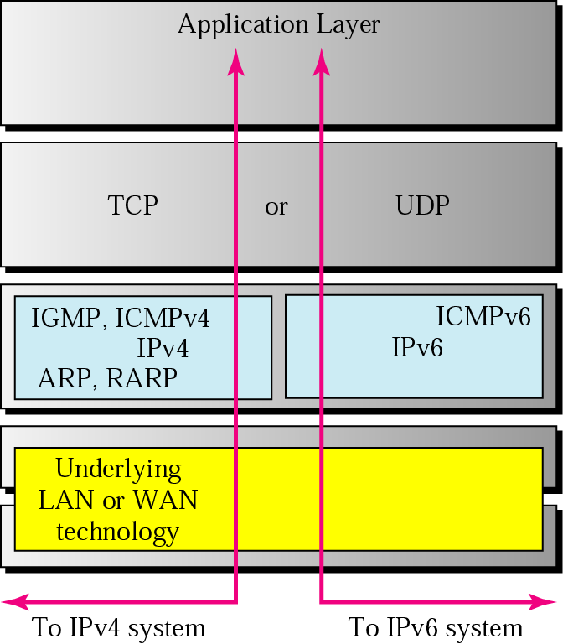
Three transition strategies
Dual stack:
A station should run IPV4 and IPV6 simultaneously until all the systems in the
internet use IPV6.
When it is necessary to send a packet to a destination, the source host queries
the DNS (Domain name system). If the DNS returns and IPV4 address, the source
sends an IPV4 packet, else if IPV6 address then it sends IPV6 packet.

Slide 48
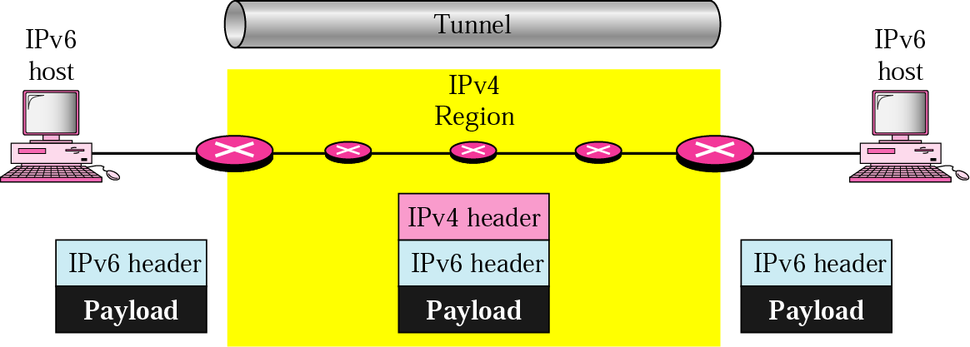
Tunneling
When two IPV6 host computers want to communicate with each other, and must
pass through a network that uses IPV4 protocol, it is used.
To pass through the IPV4 protocol region, the packet must have an IPV4 address.
So IPV6 packet must be encapsulated into IPV4 packet, when the packet enters
into the region and the protocol value is set to 41, and leaves IPV4 header when
it exits the region.

Slide 49
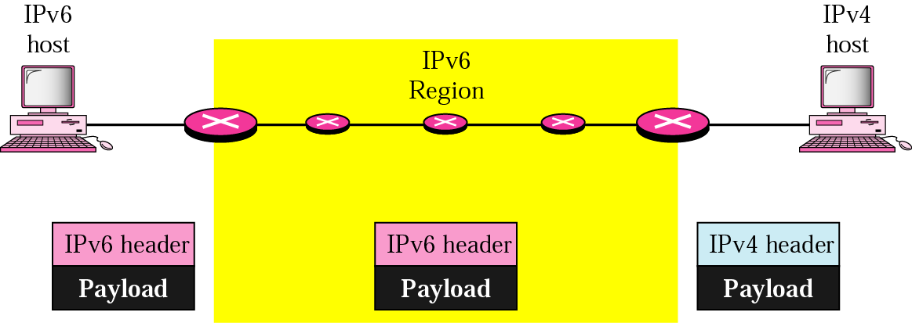
Header translation
It is necessary when majority of the internet has moved to IPV6, but some systems
still use IPV4.
Here source may want to use IPV6, but the receiver does not understand IPV6.
Tunneling is not a solution here.
Here header format must be changed totally through header translation.

Slide 50
Mobile IP
ADDRESSING
The main problem that must be solved in providing mobile communication using the IP protocol is addressing.

Slide 51

Note
The IP addresses are designed to work with stationary hosts because part of the address defines the network to which the host is attached.

Slide 52
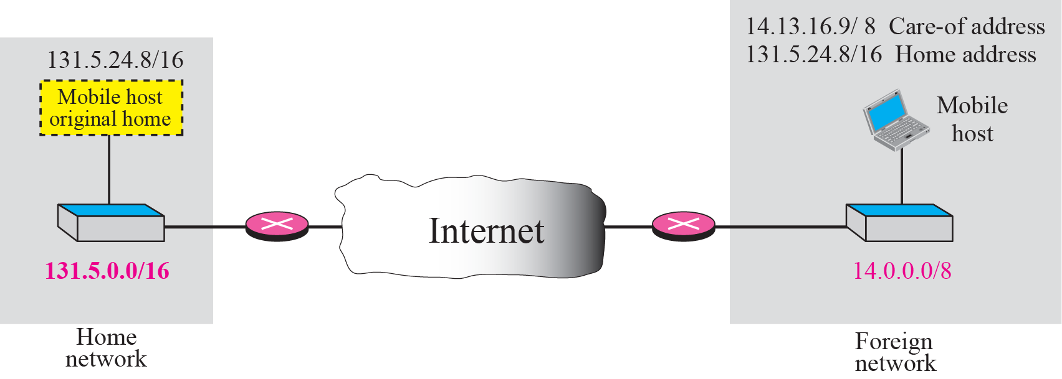
Home address and care-of address

Slide 53
Note
Mobile IP has two addresses for a mobile host: one home address and one care-of address. The home address is permanent; the care-of address changes as the
mobile host moves from one network to another.

Slide 54
AGENTS
To make the change of address transparent to the rest of the Internet requires a home agent and a foreign agent.

Slide 55
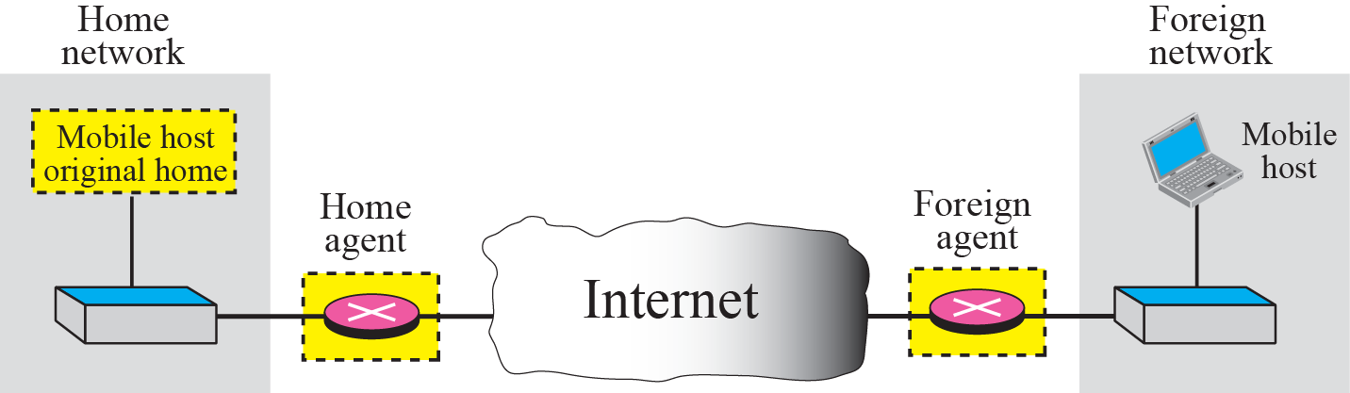
Home agent and foreign agent

Slide 56
Note
When the mobile host and the foreign agent are the same, the care-of address is called a colocated care-of address.

Slide 57
THREE PHASES
To communicate with a remote host, a mobile host goes through three phases: agent discovery, registration, and data transfer.
The first phase, agent discovery, involves the mobile host, the foreign agent, and the home agent. The second phase, registration, also involves the mobile host and the two agents. Finally, in the third phase, the remote host is also involved. We discuss each phase separately.

Slide 58

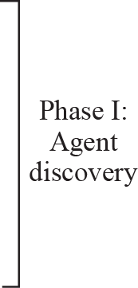



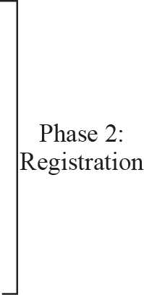





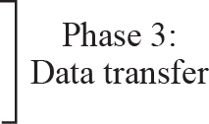
Remote host and mobile host configuration

Slide 59
Note
Mobile IP does not use a new packet type for agent advertisement; it uses the router advertisement packet of ICMP, and appends an agent advertisement message.

Slide 60
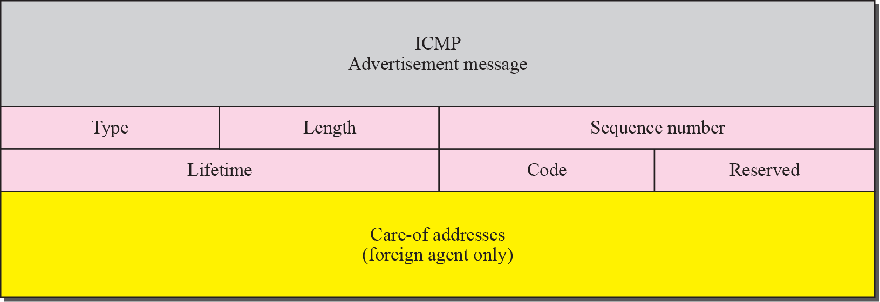
Agent advertisement

Slide 62
Note
Mobile IP does not use a new packet type for agent solicitation;
it uses the router solicitation packet of ICMP.

Slide 63
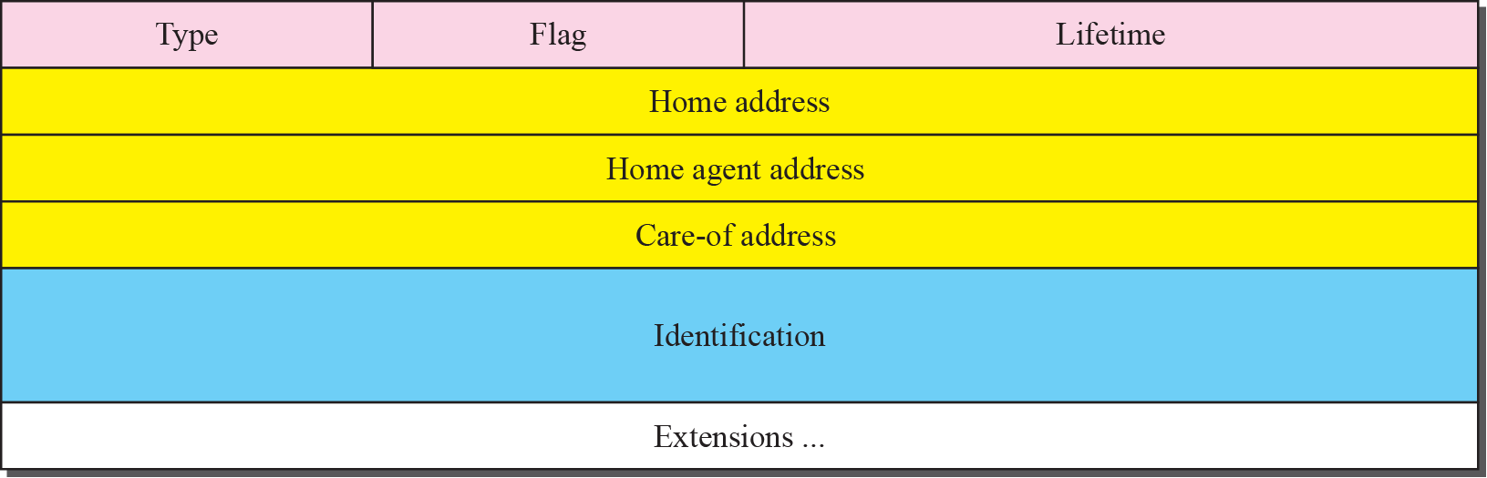
Registration request format

Slide 65
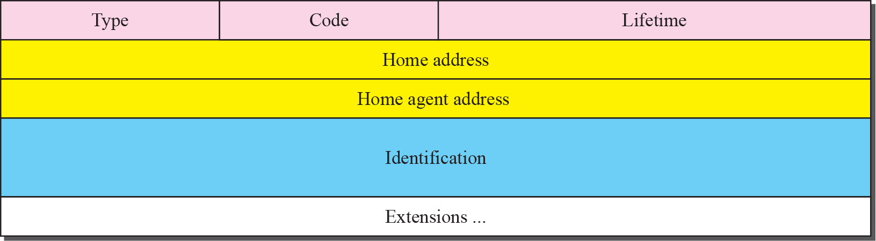
Registration reply format

Slide 66
Note
A registration request or reply is sent by UDP using the well-known port 434.

Slide 67
Figure 10.7 Data transfer

Slide 68
Note
The movement of the mobile host is transparent to the rest of the Internet.

Slide 69
10-4 INEFFICIENCY IN MOBILE IP
Communication involving mobile IP can be inefficient. The inefficiency can be severe or moderate. The severe case is called double crossing or 2X . The moderate case is called triangle routing or dog-leg routing.

Slide 70
Double crossing

Slide 71
Triangle routing

